Slide 1
2025 Troop Cookie Manager Training
Engaging Girl Scouts & Families
Notes:
Hello and welcome to the second session of the Troop Cookie Manager Training for 2025.

Slide 2
Online Training Series
Five Training Videos
Cookie Program Overview
Engaging Girls Scouts and Families
Managing the Cookies
Managing the Cookie Finances
Smart Cookies
Notes:
This is the second in a series of five training videos. This session is filled with information on engaging Girl Scouts and families in the cookie season.

Slide 3
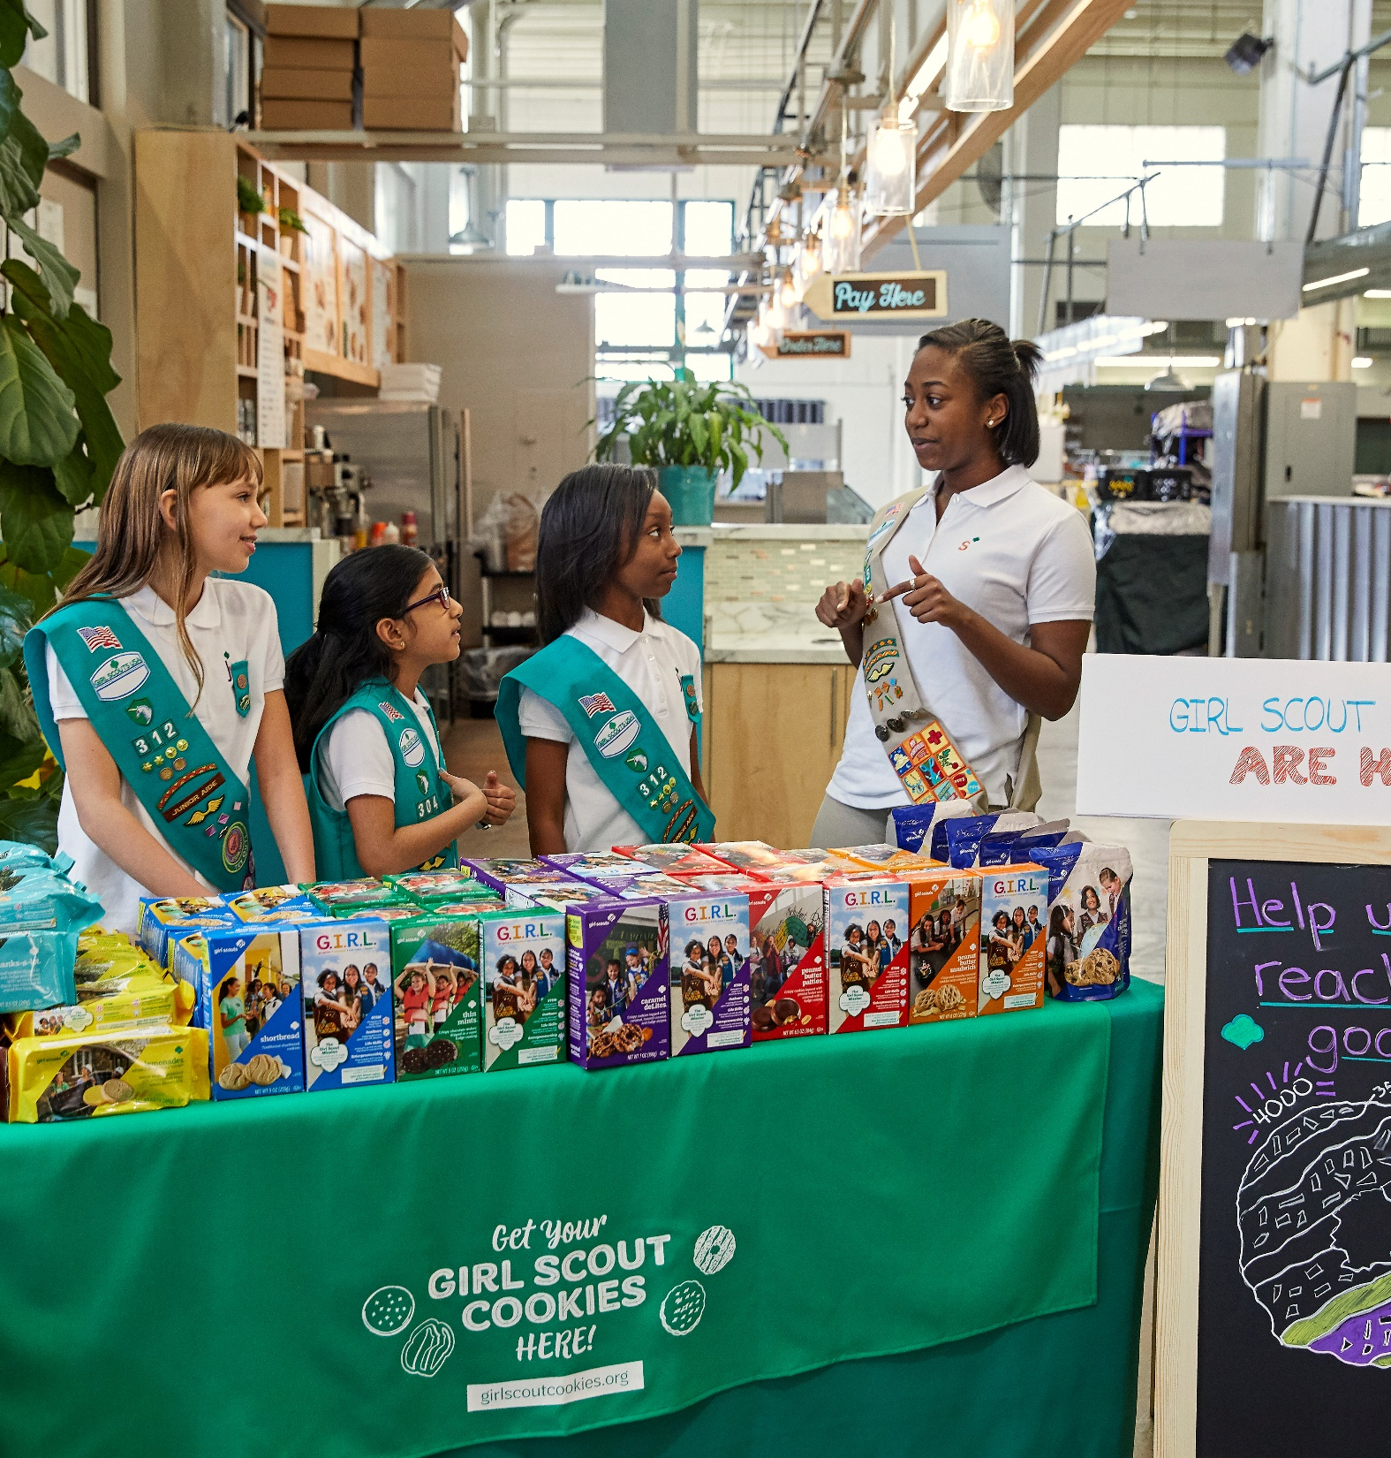
Section Topics
Ways to sell
Booths
Cookie Share Donation Program
Rewards
Cookie Rallies
Cookie Badges and the Family Entrepreneur Pins
Cookie Policies
Cookie Open Houses
Notes:
Here’s what we will cover during this section:
We’ll go over the many ways Girl Scouts can sell Cookies
We’ll take a look at Cookie Booths
We’ll go over the Cookie Share Donation Program
Next, I’ll tell you about our rewards for 2025
You’ll hear about the Cookie Rallies
We’ll go over Cookie Badges and the Family Entrepreneur Pins
I’ll tell you more about the GS Cookie Policies
Last, about Cookie Open Houses

Slide 4

Ways to Sell
There are many ways for Girl Scouts to participate. Encourage families to choose the option(s) that work best for their Girl Scout.
Review the information in the Troop Cookie Guidebook & Family Guide
Notes:
When we say we aim to make the Cookie Program accessible, flexible, and customizable so every Girl Scout has a path to participation, we really mean it. You’ll work with the families and Girl Scouts in your troop to share the many ways to sell so they can determine the option that works for them. Let’s take a closer look at the most common ways to sell. You’ll find more details in our Troop Cookie Guidebook on Cookie Central and in the Family Guide from your cookie print materials.

Slide 5
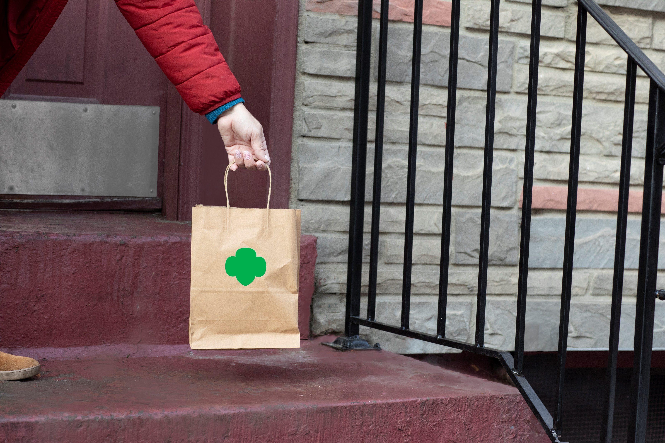
Ways to Sell
Cookies On Hand:
Girls canvas the neighborhood for eager cookie customers
Leave door hangers/business cards
  Printable resources on Cookie Central
Notes:
One of the most foundational ways to sell cookies is going door to door with cookies on hand. Girls will load up their sled or wagon with their inventory and visit their neighbors who are excited to purchase. They can leave door hangers or business cards for customers that aren’t home, you’ll find these printable resources on Cookie Central. This gives customers who aren’t home the option to purchase from her sales link or contact her adult to complete the sale.

Slide 6

Ways to Sell
Online sales
Digital Cookie is the online sales platform
Share unique sales links:
  Customers pay online for local delivery or have cookies shipped to their door
Send marketing emails to customers
Digital Cookie Mobile App for processing in-person payments
Notes:
Online sales are an effective sales channel that is becoming more and more popular. Girl Scouts that utilize their Digital Cookie account sell more cookies. In fact, on average, they sell over 190 packages more! After setting up their Digital Cookie site, girls can share unique sales links with customers. From this link, customers can pay online for cookies to have delivered in-person by the Girl Scout and their caregiver, or they can choose to have cookies shipped to their door. Girls can choose to turn on and off their sales link for in-person delivery at any time during the sale. Along with sharing sales links, girls can also send marketing emails to customers with three options available in their site.
Girls will use the Digital Cookie mobile app to take credit card/Venmo/Paypal payments when they are selling on the go. We’ll cover Digital Cookie in more detail in our video series.

Slide 7
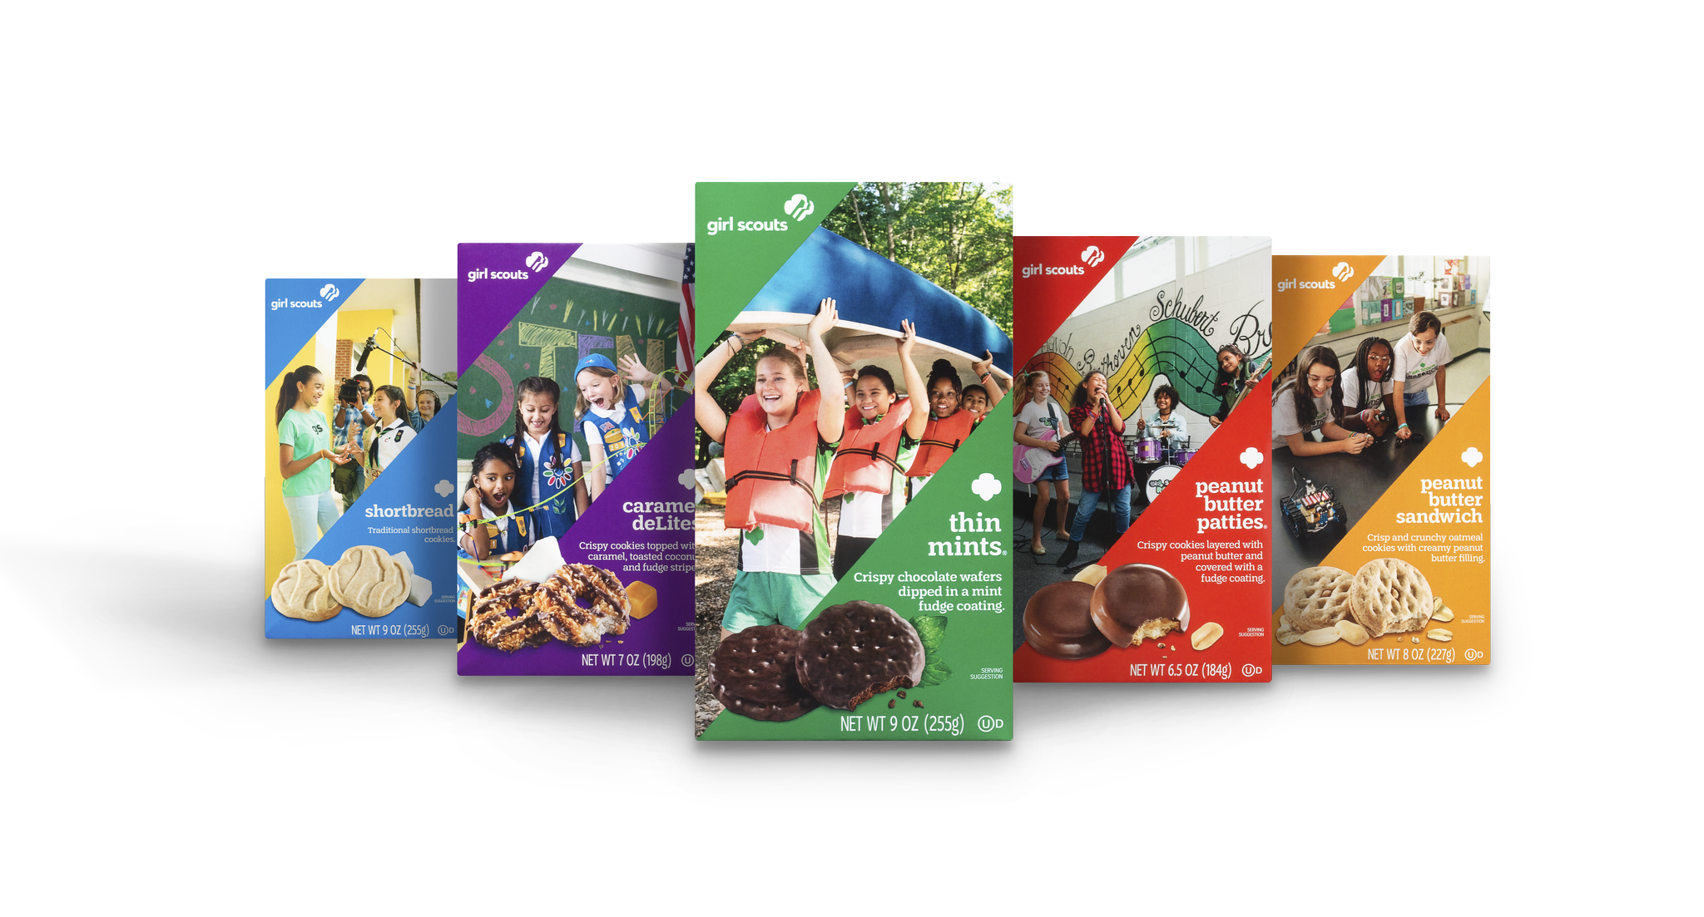

Ways to Sell
Workplace Sales:
Virtual or in person
Connect with customers with a letter or video
Business to Business (B2B) Sales
Pitch your cookie business to a local business
Connect with community organizations to sell at an upcoming meeting
Notes:
Girl Scouts can team with their caregiver to take orders at their workplace, whether in-person, by email, or with an order card. Keep it girl-led by including a personal statement to inform customers of their personal and troop sales goals.
Girl Scouts and/or troops can pitch their cookie business to a local business, who in turn, give cookies to their customers or clients as a thank you or gift. Connect with community organizations to set up a time to sell to members during their scheduled meetings.

Slide 8
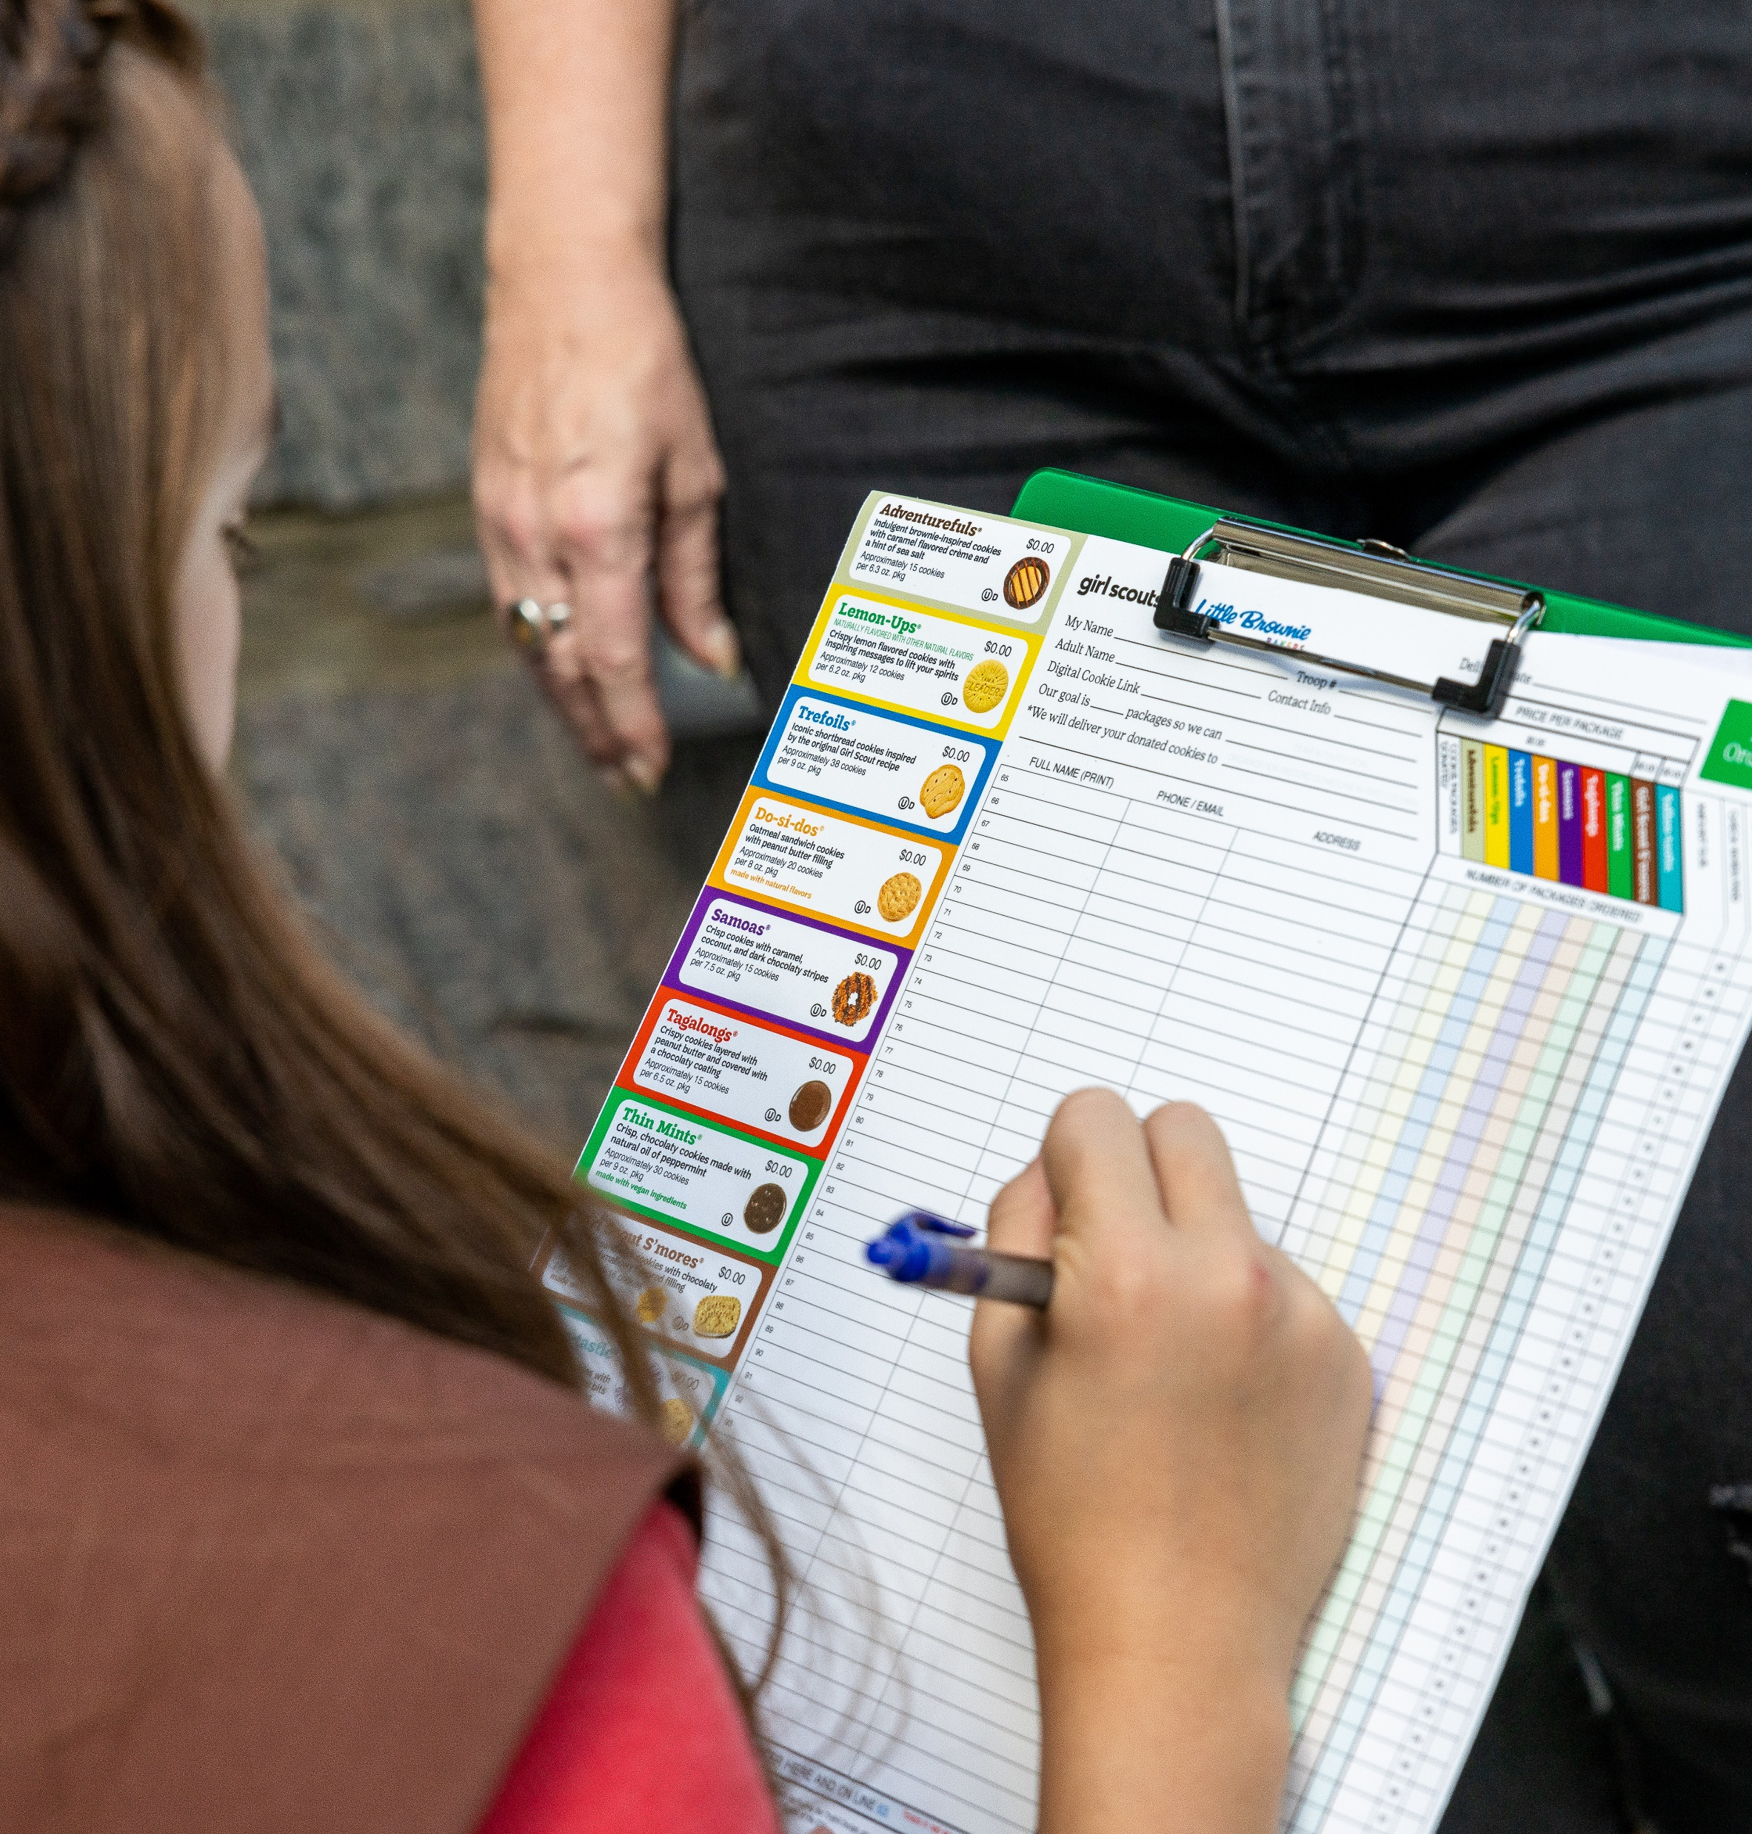
Ways to Sell
Phone/text:
Call customers to collect orders
Text customers the Digital Cookie sales link
Order taking:
Collect orders, deliver later
Notes:
Girls can team with their caregiver to call customers to collect orders or text them their Digital Cookie sales link.
They can also use their order card to go door to door to record orders, then deliver the cookies and collect payment later.

Slide 9
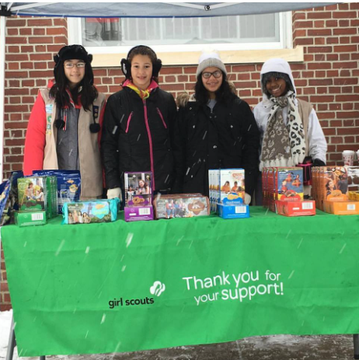
Cookie Stands
Notes:
There’s no easier booth than the one that can be set up in the neighborhood! Girl Scouts set up a Cookie Stand in their yard, which is basically a cookie booth on a person’s private property. Girls can work with the parent/guardian for a solo opportunity or team with their Girl Scout sisters and make it a troop-secured opportunity. That way, they’ll be able to use Digital Cookie to process credit card payments and enter sales in the Smart Booth Divider to give credit to those that worked at the stand.

Slide 10
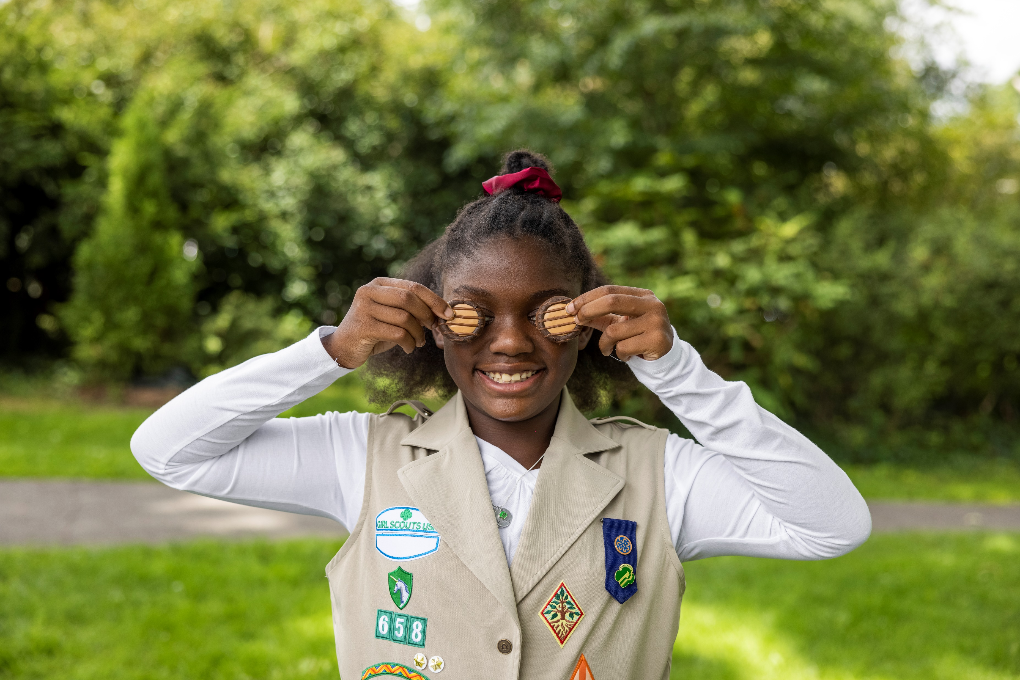
Cookie Pre-Sales & Online Sales
Pre-sales & Online sales begin on February 12
Connect with cookie customers early
Record cookie orders on order card and/or share Digital Cookie site/emails
Deliver on Cookie Go Day February 21
Notes:
So now that you know the multitude of ways that your Girl Scouts can sell cookies, let’s talk about WHEN they can start selling.
Pre-sales and online sales will begin on February 12. This allows your Girl Scouts to connect with your cookie customers early and spread the excitement of the new cookie season. Girl Scouts can take orders on their order cards during this time or share their Digital Cookie site information to get a jump start on the cookie season.
Remember - Girl Scouts will not have physical cookies until they pick-up their inventory from you. They can begin delivering cookies to their customers on Cookie Go Day, Feb 21.

Slide 11
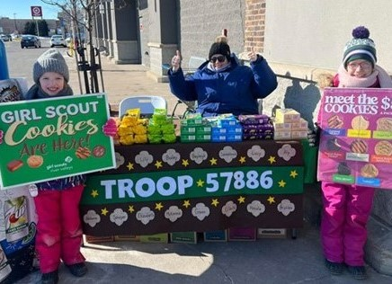
Ways to Sell
Cookie Booths
Troops attended a total of 19,256 cookie booths in 2024!
Average sales per hour: 26
Booth hours by chain:
  Troop Secured 37%
  Cub 26%
  Walmart: 19%
Notes:
Now let’s turn to cookie booths, which are one of the most popular ways to participate as a troop in cookie sales. Cookie booths are also one of the most visible ways the public sees Girl Scouts in their communities. Did you know that of the 3.3 million packages that were sold LY by River Valleys GS’s, over 30% of these sales were made through booths?
Not only are booths a great sales opportunity, but girls have a ton of fun too! Here’s a few booth stats to share with you. Our average sales per hour across all booths was 26 pkgs in 2024. When it comes to the booth locations where troops were at the most, Troop Secured Cookie Booths was the most with 37%, followed by Cub cookie booths at 26% and Walmart rounding up the top 3. Cookie Booths are truly a great way to get out there, sell cookies alongside troop members and have a great time!

Slide 12







Cookie Booths: Council-secured Partners
Notes:
We’ve been working so hard to line up a wide variety of council-secured cookie booths this year. As you can see here on the screen, we have lots of fantastic partnerships in progress including Mall of America, and several other Minnesota malls, Goodwill, Hy-Vee, JoAnn’s, the Minnesota Wild games, and much more! Good news, we’ll also continue our partnership with Walmart and Sam’s Club. Finally, we are thrilled to continue our local Cub Partnership for another year. You can see the special 2025 cub patch here that troops can earn by selling at a Cub booth location.

Slide 13
Cookie Booth Sign-up Calendar: Council-Secured Booths
January 15 – 19 at 11 AM | Booth Lottery Selections
January 19 at 12:00 PM | Booth Lottery Runs
January 22, 23, 24, 25, and 31 | First Come, First Served (FCFS) Booth Dates
February 1 | All Cookie Booths Open
Notes:
Now, let’s talk about cookie booths and when troops can start to secure these. This year, the Lottery selections open January 15, and will close January 19 at 11am. The lottery runs on January 19 at 12:00pm.
These dates will also be featured in The Cookie Press and on Cookie Central.
Troops may choose up to 10 booths to add to their lottery list, and spots are chosen at random. It is advantageous for troops to select 10 booths, rather than just 1 or 2 that they really want. Choosing only 1 or 2 could mean you end up with zero. From the lottery, troops will receive 1 booth. This is the best way to distribute booths as fairly as possible, and make sure everyone has equal access to booths. In the uncommon instance that your troop is not awarded a booth in the lottery, watch your email for information on us on how you can still secure a booth before the First Come First Served Rounds begin.
Speaking of booth rounds, starting on January 22, First come, first serve booths start and continue through the end of the month. Booth selections will close at 4 PM each of those days to allow us time to upload any additional booths. Then at 7 PM, they will re-open with additional spaces open for troops to add to their current selections. There’s a set number of new booths that troops will be able to reserve during these rounds.
On February 1st, the cap on booth selections will be lifted, and troops can select any additional booths they would like. If these dates change, we will be sure to update you in The Cookie Press.

Slide 14
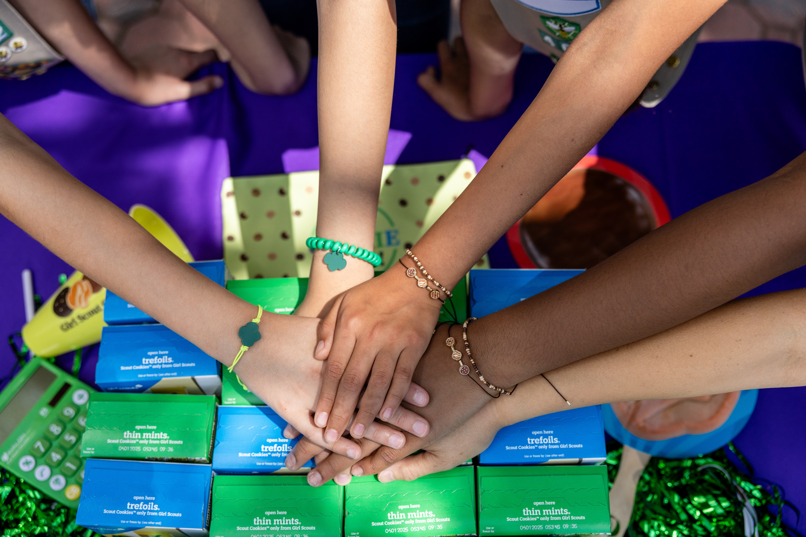
Troop-secured Cookie Booth Tips
Submit Troop-secured requests as early as possible (72 hours minimum)
Two troops accidentally show up for the same timeslot?
Top reasons a request is declined:
  Another troop has already secured that timeslot
  Location is too close to another booth
  We will always give an explanation for why a booth was declined in the in the approve/decline email
Overcome the "us versus them" mentality. We are all part of the Girl Scout family!
Notes:
Troop-secured booths continue to rise in popularity. There’s so much opportunity out there! As members of your community, you and your families know the best spots in town to sell cookies and can foster personal relationships with booth partners. Plus, there’s lots of opportunities to tailor the experience to meet the needs of your troop and your booth partner.
With literally thousands and thousands of troop-secured booth requests to review and approve, we wanted to share some tips on ways you can assist us in the approval process along with tips in case issues arise with booths.
Submit your booth requests as early as possible – we ask for a minimum of 72 hours prior to the start of the booth. If your booth is declined, it would be for several reasons. The most common reasons are:
Another troop has already secured that timeslot
Location is too close to another booth
We always explain why in the approve/decline email
When it comes to cookie booths, remember we are all in this together! There are plenty of businesses and organizations that want to support troops in reaching their goals. It’s important to review booth expectations with your Girl Scouts and families, including how to interact with customers, handle conflicts, the importance of timely shift changes between troops, and following booth location policies. Coaching Girl Scouts and families on booth expectations is important, as booths are the most public way people see Girl Scouts in the community. By preparing your troop for what to expect, both the booth location and your Girl Scouts can have the best experience possible.
.

Slide 15
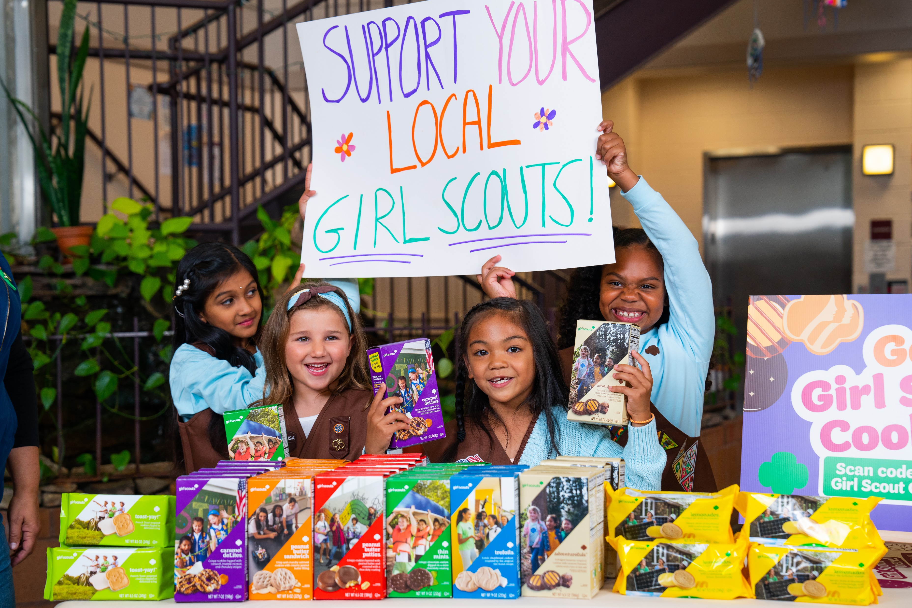
Troop-secured Booth Ideas
Drive-thru booths
Family–friendly Craft breweries
Convenience stores
Car dealerships
Places of worship
Cookie Stands
Review two updated lists on Cookie Central:
Do Not Contact & Newly Available
Notes:
What are some ideas for troop-secured booths? We’ve seen some creative booth options: hosting drive-thru booths in large parking lots, sales at family-friendly craft breweries, convenience stores, car dealerships, places of worship, clubs like the VFW and American Legion, and Cookie Stands….that’s just to mention a few of the options. Work with your troop and families to think beyond council-secured booths and brainstorm ideas for high-traffic areas in your community that would be locations conducive for a cookie booth.
As we mentioned in our program overview, there are additional troop-secured booth opportunities that have historically been council-secured locations. You can check out the Newly Available list to booths that your troop can reach out to (for example, all GNC and Dunkin Donuts are available as troop-secured booths ONLY beginning this year). Troops can also review the historical booth sales data on Cookie Central and in Smart Cookies, along with any special booth instructions. And we’ll feature a special cookie chat session that focuses on booths before Cookie Go Day. Don’t worry, all of these lists will be updated on Cookie Central and sent out via The Cookie Press.

Slide 16
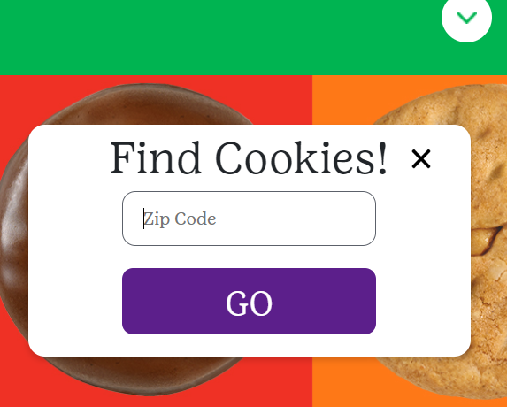
Cookie Booth Resources
GSUSA Cookie Finder
Cookie Booth Guide
Cookie Central/Smart Cookies
  Sales per hour, booth instructions, step-by-step instructions
Cookie Chat on Booths
Items for sale in the GSRV Retail shop
Notes:
We have opportunities to promote cookie booths & resources to assist troops with their booths. Customers looking for cookies can use the Cookie Finder on our website to locate a list of booths near their zip code or place an order for cookies to ship to their home to benefit a local troop.
Our Cookie Booth Kit will be sent in your troop materials shipment with updated resources, including new posters and fliers.
And don’t forget to check out Cookie Central and Smart Cookies to find the sales per hour of booths, step by step instructions, and more.
Our retail shops also feature fun marketing items that troops can purchase to help them set up an inviting booth display.

Slide 17

Cookie Share Donation Program
Types of Donations:
Virtual Cookie Share (Council Inventory)
Tracked Cookie Share (Troop Inventory)
Donations come from:
Shipped Cookies
Booth Pick Up
Girl Scout Delivery
Cookies In Hand
Cookie Booths
Notes:
Next, let’s talk about our Cookie Share Donation Program. The Cookie Share Donation Program allows troops to give back through the power of cookies. Your troop may choose to participate in one or both options. The two types of cookie donations that a troop can take part in.
Virtual Cookie Share, where the Girl Scout accepts donation payment, turn it into the troop, and you (the troop volunteer) record these sales. After the sale ends, River Valleys donates the cookies to our partner organizations. The troop does not take physical possession of the cookies.
Tracked Cookie Share, where the Girl Scout accepts payment and the cookies are donated by the troop directly to an organization of their choosing. Examples of organizations to donate to include: military or fire departments, food shelters, school lunch programs, churches, homeless shelters, and more! As the troop volunteer, you record these sales and donate the cookies at the end of the season.
There are also several ways that a troop or Girl Scout can accept a donation payment from their customers. The types of sales where a donation may be given include: shipped cookie sales, booth pick up link, girl scout delivery link, cookies in hand payment, or at a cookie booth. Donations can come via cash, check, OR an online payment.

Slide 18
Cookie Share Donation Program & Council vs. Troop Inventory
Any donation can go towards Virtual Cookie Share (council inventory)
Donations that ONLY go to Virtual Cookie Share (council inventory):
Donations accepted from a digital cookie shipped-only order
Donations accepted from the troop’s booth pick up link.
Most donations can go towards Tracked Cookie Share (troop inventory)
View Managing Cookie Donations in Smart Cookies tip-sheet
Notes:
The question we were asked the most last year was – how do I know if a donation can go towards tracked cookie share (my troops inventory) or virtual cookie share (from council’s inventory)? Let’s review this in detail.
On the chart you can some of the different ways a girl scout may accept a donation from a cookie customer.
With most donation types your troop can choose either donation option. However, the two donation types where this is not the case would be donations accepted from a digital cookie shipped order and donations accepted from your troop’s booth pick up link. Both types of donations can only go towards council inventory.
For those donations received via a shipped order, the donation is credited to the girl scout automatically and there is no additional steps needed in Smart Cookies . You can view this donation on the Girl Cookie Detail Report in Smart Cookies under the Virtual Cookie Share column. (More on this in a minute).
For those donations received via your troop booth pick up link...meaning your troop had an existing booth to which you added a booth pickup option for customers to pre order and pick up cookies. This is also automatically credited to virtual cookie share and there is an action you will need to take in Smart Cookies. You can view the booth pick up sale in the Booth Tab. It will show as a Virtual Booth Pending Distribution. This donation will automatically be entered in the virtual cookie share column, but you will need to allocate the sales using the smart booth divider for the Girl Scout(s) to get credit for the sale.
We know donations can be confusing. For more information, you can view the Managing Cookie Donations in Smart Cookies Tip-sheet and we will share more information on donations in The Cookie Press.

Slide 19
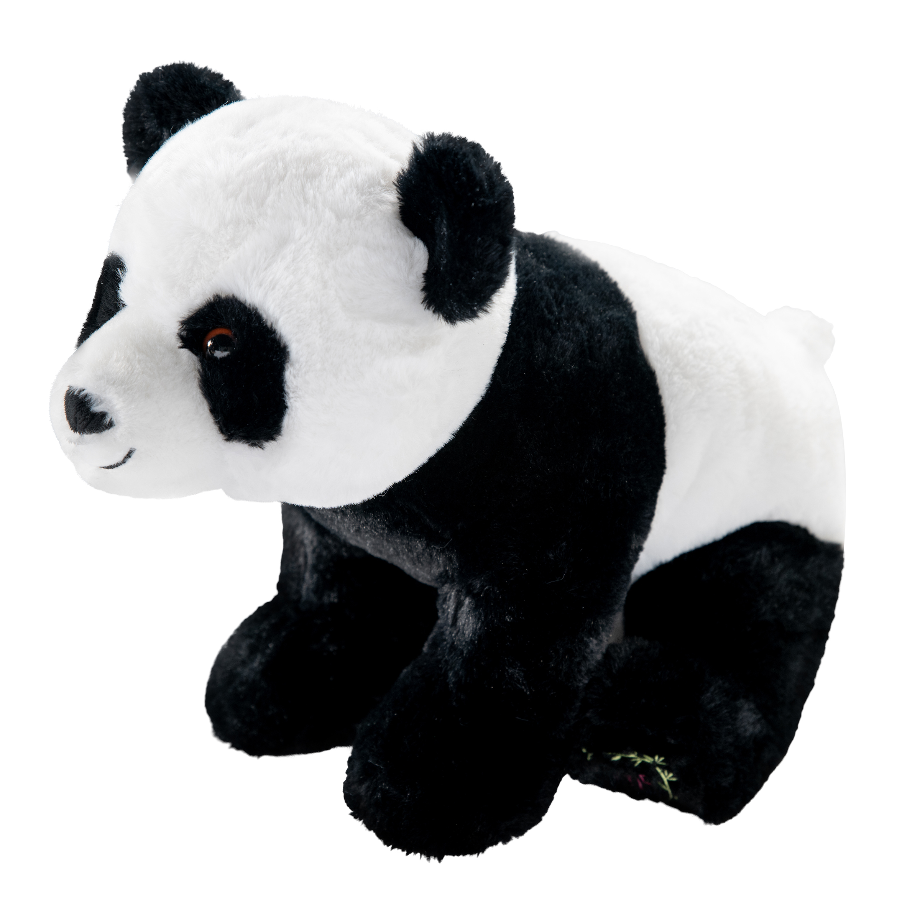
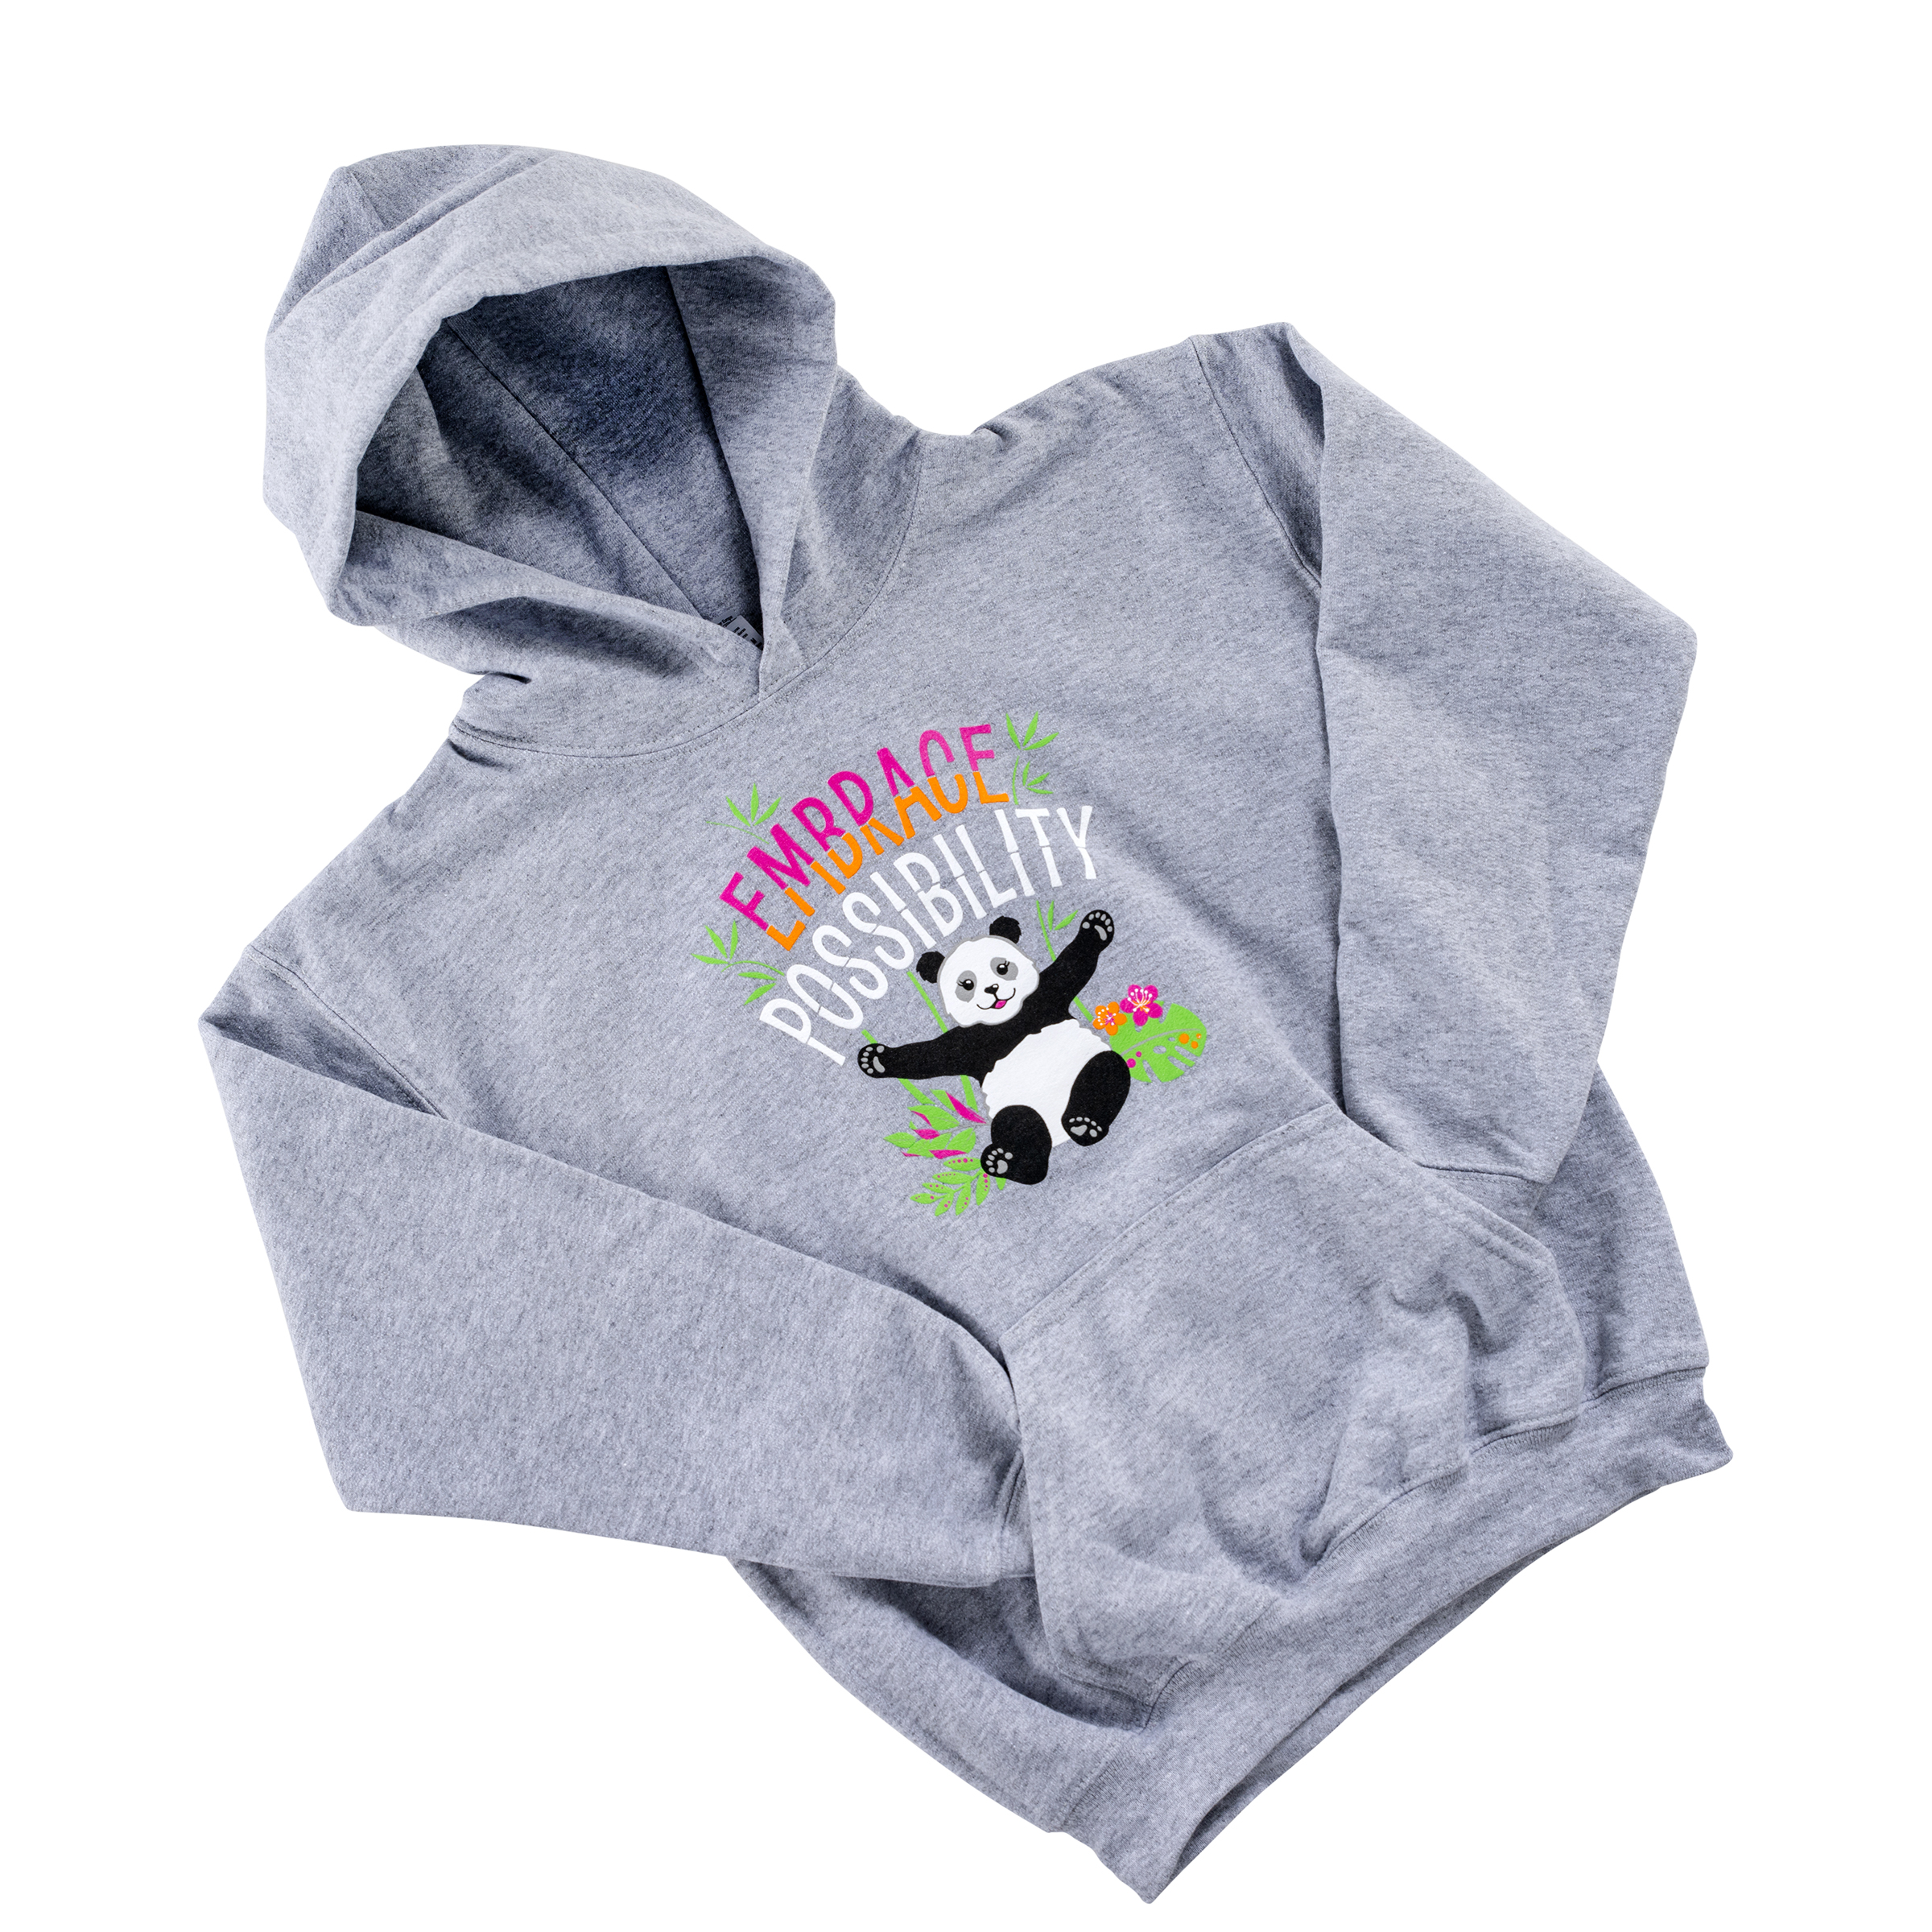
Cookie Rewards
New & returning items
Cookie Credits & Camp Coupon
Troop PGA rewards
Full details on Cookie Central & in your cookie materials shipment
Notes:
We’ve carefully crafted another fun collection of rewards that include 2 sizes of Noodles the mascot plush, wearables like a t-shirt or a hoodie, accessories, events, patches, and more! Along with reward items, Girl Scouts have the option to choose Cookie Credits which can be redeemed for lots of options to fund their adventures.
You can direct FAMILIES to Cookie Central to learn more about our rewards, credits, and events. Plus, we feature a flyer that features our entire reward line up that you'll find in your troop materials that you will distribute to each member. River Valleys will also send a post card to each registered Girl Scout before the sale begins with showcase the rewards they can earn through the program.

Slide 20

Community or Virtual Cookie Rally Options
Community-led Cookie Rally
ABC Rally Guide
Council-wide Virtual Cookie Rally on February 4
Notes:
A Cookie Rally is a great way to kick off the season for your troop members! Is your Community holding a rally? Check in with your Community Product Leader to get the details.
Another rally option is our free, virtual cookie rally event that will take place the evening of February 4. You can watch this exciting event live on our Youtube and Facebook pages. Watch for more information on the rally coming in The Cookie Press.

Slide 21

NEW: Cookie Seller Spotlight
Girl Scouts and troops can submit their unique cookie skills, customer service, marketing materials, or best pro tip to close the sale
One winner from Daisy/Brownie/Junior & Cadette/Senior/Ambassador submissions
Cookie Spotlight Seller of the Year
  Grand prize: an exclusive Dave and Buster’s experience
Notes:
Whether it’s a hot tip on how to set up a rockin’ booth, a story on how your troop went above & beyond in customer service, a great marketing display-or a selling tip to share with other Girl Scouts, we have a new patch program to shine the spotlight on your creative cookie sellers! It’s the River Valleys Cookie Pro patch program. This new and exciting patch program is the newly revamped Cookie Pro, which you may remember from last year. You can submit an entry as a troop, or Girl Scouts can submit their own stories on Cookie Central. Each week, we’ll pick a winner from all DBJ entries and one from CSA entries. The weekly winners will receive our exclusive Cookie Seller Spotlight patch plus be entered into the drawing where they could win the grand prize of a Dave and Buster’s experience for the troop! Even if your troop isn’t a winner, they may still get the chance to be featured on our social media pages for their excellent work! Watch for more details in The Cookie Press. This is a great way to shine a spotlight on your cookie sellers and share with others how they are doing a great job in your troop.

Slide 22
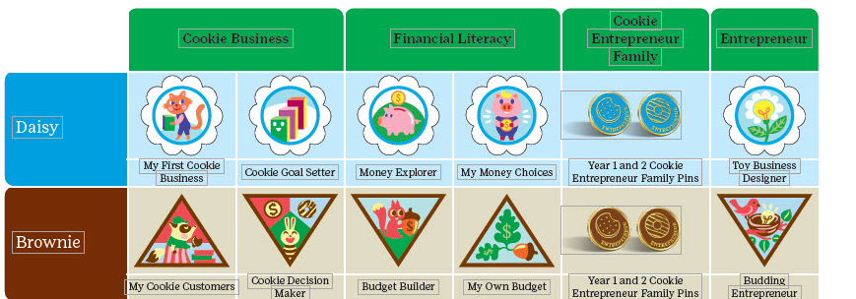
Cookie Badges & Pins
Visit Cookie Central’s For Fun section and the Volunteer Toolkit for more information
Notes:
Another way to engage Girl Scouts is to incorporate the Cookie Badges. These can be earned each year as a Girl Scout grows with the program. Resources for these badges are found in the Volunteer Tool Kit. Or check out Cookie Central’s For Fun section for a downloadable PDF with a complete list of Cookie Badges for all Girl Scout levels.
Your cookie business = a family affair. Families can get in on this too, with the Cookie Entrepreneur Family Pin! It's a different pin every cookie season, that is earned with simple, age-specific guidelines. Once a family has finished all the steps to receive a pin, they can purchase it either online or through our River Valleys Shop.

Slide 23
Online Cookie Policies
Policies can be found on Cookie Central
No changes from 2025
Cookie digital sales policies remain in place
  No Sales on Craigslist, eBay, Facebook Marketplace, or any Garage Sale Sites
  Contact River Valleys if you have further questions
Notes:
It’s important to review our cookie policies so you and your families know where to turn for a clear understanding on their responsibilities and so they have the tools to help ensure a safe, equitable, and positive cookie experience. You can access our cookie policies from Cookie Central. Policies remain the same from last season.
The policy we tend to get the most questions on is the digital sales policy. As a reminder, sales on Craigslist, eBay, Facebook Marketplace, & Garage Sales Sites-all are still not allowed for 2025. If you have further questions after reviewing policies, feel free to contact us.

Slide 24

You’re Invited!
Cookie Retail Open Houses
Open House Dates:
Brooklyn Center Retail Shop: Jan. 25, 9am – 1pm
Mankato Retail Shop: Jan. 25, 10am – 1pm
St. Paul Retail Shop: Feb. 1, 9am - 1pm
Rochester Retail Shop: Feb. 1, 10am - 1pm
Notes:
Mark these dates on your calendar! We invite you to the Cookie Retail Open House events that start in January. Our River Valleys retail shops will have fun cookie-themed merchandise for both adults & Girl Scouts along with items to help with your cookie sale such as signs, cookie carts, money bags, & more. Come into the shop on these special dates and have some fun while you are at it! We’ll be featuring prize drawings, games, cookie sampling, the chance to view the cookie rewards, plus test out Digital Cookie site if you’d like, and meet the Product Program Team! The dates are listed on the screen, and we’ll send out more information in The Cookie Press. We look forward to seeing you and celebrating the start of the season!

Slide 25
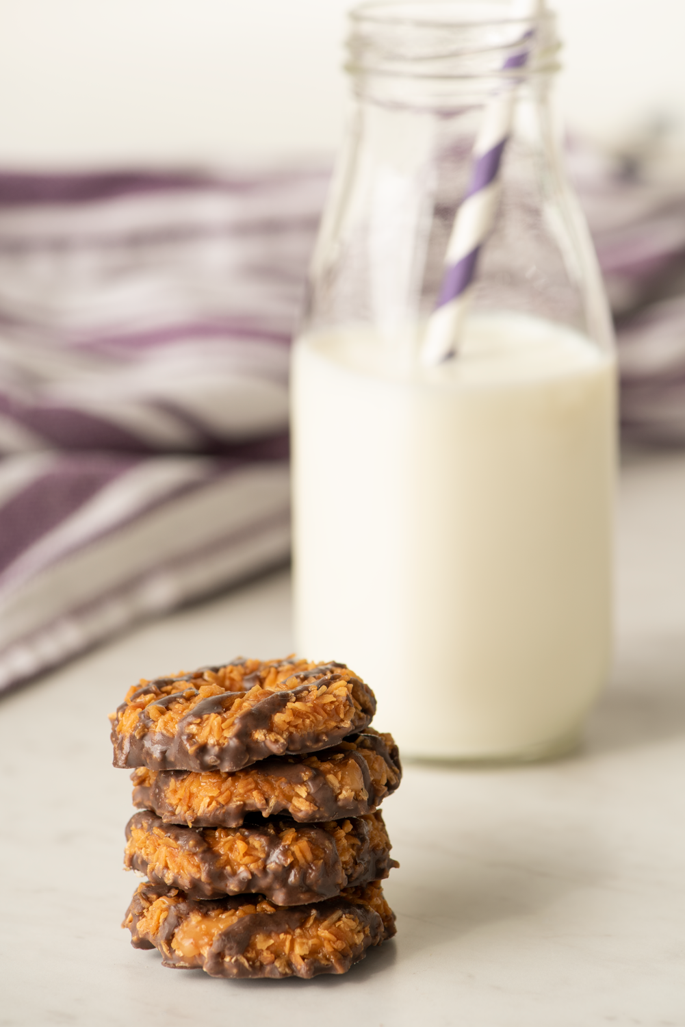
Key Takeaways
There are many ways to participate, based on comfort level
Council and Troop-Secured cookie booths, resources, & guidelines
River Valleys features programs, like our Cookie Share donations, reward program, & patch opportunities for all Girl Scouts
Virtual Cookie Rally and retail open house events
Review our Cookie Policies
Notes:
To review our key takeaways from this section-
There are many ways to participate in cookie sales, based on the comfort level of your troop and individual Girl Scouts.
We learned there are two types of cookie booths, council-secured and troop-secured and we went over booth resources, & guidelines
River Valleys features programs, like our Cookie Share donation program, reward program, & patch opportunities for all Girl Scouts
Mark your calendars to join us for our virtual Cookie Rally and our retail open house events
Review our Cookie Policies so you are familiar with the guidelines. The policies remain the same from last season.

Slide 26
THANK YOU!
Next Up: Managing the Cookies
Notes:
This concludes our topics on engaging Girl Scouts & Families. The next video will focus on Managing the Cookies, where we’ll discuss the initial cookie order, deliveries, cupboards, inventory management, & more.

